Slide 1

An IoT Based Health Monitoring System With Medicine Box
Under supervision of :
Prof. Imane Aly Saroit Ismail
IT department
Mahmoud Ramadan Sayed 20180252
Ahmed Mohammed Ibrahim 20180021
Mohammed Ahmed Abdelrahman 20180214

Slide 2
Problem Definition
Why we thought about this idea? - To improve health care level in local level and perhaps the international level, To help health institutions, physicians, and nurses during the hardest time
Specially the health is the fundamental element of the people's need for a better life
The global health has created a dilemma because of certain factors such as poor health services, the presence of large gaps rural and urban areas

Slide 3
The advantage of technology use
The increased usage of mobile devices smart devices in health field or healthcare field like (Fitbit, Mi-Fit and etc.) and using IoT or GSM or Wi-Fi Module or Bluetooth Module for monitoring the health parameters has made a great impact and helped us to make this project, and use this components and moules to grow up and produce a new projects in health field

Slide 4
Patient’s life cycle
The smart patient health tracking system uses sensors to track patient vital parameters
Display the parameters on the local screen
Sending and receiving information from the platform
Using internet to update the doctors and gives the patient the medicine So that they can help in case of any issues at the earliest
preventing death rates so the doctor will be fully aware of the patient's condition all the time

Slide 5
Objectives
Helping the nursing staff and institutions of health during the hardest time
Helping patients and their families by monitoring the patient's condition around the day
Reduce the health care cost and minimize the risk

Slide 6
The System usability
This project can be called a line following robot it can act as a temporary nurse, It can assist hospital staff in case of any emergency
It can be used also in house for patients that lying down in home

Slide 7
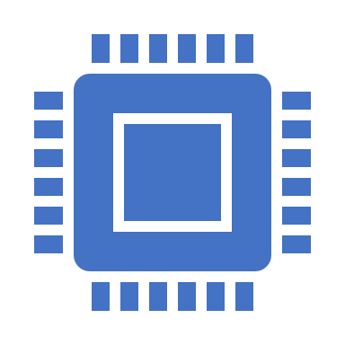
Project mechanism
The project based on IoT technology that allow to us communicate and interact with the patient's condition
Then the patient's condition parameters sensed by the sensors and then it will be sent to the processing unit (ARDUINO UNO) to process the parameters and display it on the OLED screen
Send it to the cloud server to store it and analyze it to check if there is difference between the old displayed parameters and the new parameters
The doctor will be informed by the app that the platform provided it to us

Slide 8
Project mechanism
Then the patient and the doctor can access the data in the same time by the OLED and the application
If there is any changing the doctor will know and the server will send order to the robot unit to go to the patient and give him the medicine that approved from the doctor
During that the doctor keep updated about the patient's physical health

Slide 9
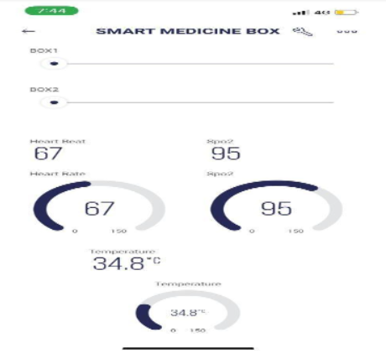

Illustrative image
Blynk application monitoring

Slide 10
Project mechanism
How the robot unit will go to the patient?
We will construct a track for the robot unit to walk on it
The track will be colored for example the red color will be for the straight forward and the blue color will be for the turn right and the green color will be for the turn left
When the robot will reach the destination it make a buzzer to alert the patient

Slide 11
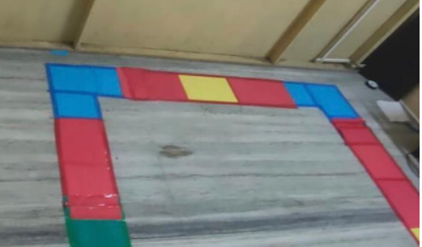
Illustrative image
Robot unit track

Slide 12

System definition

Slide 13
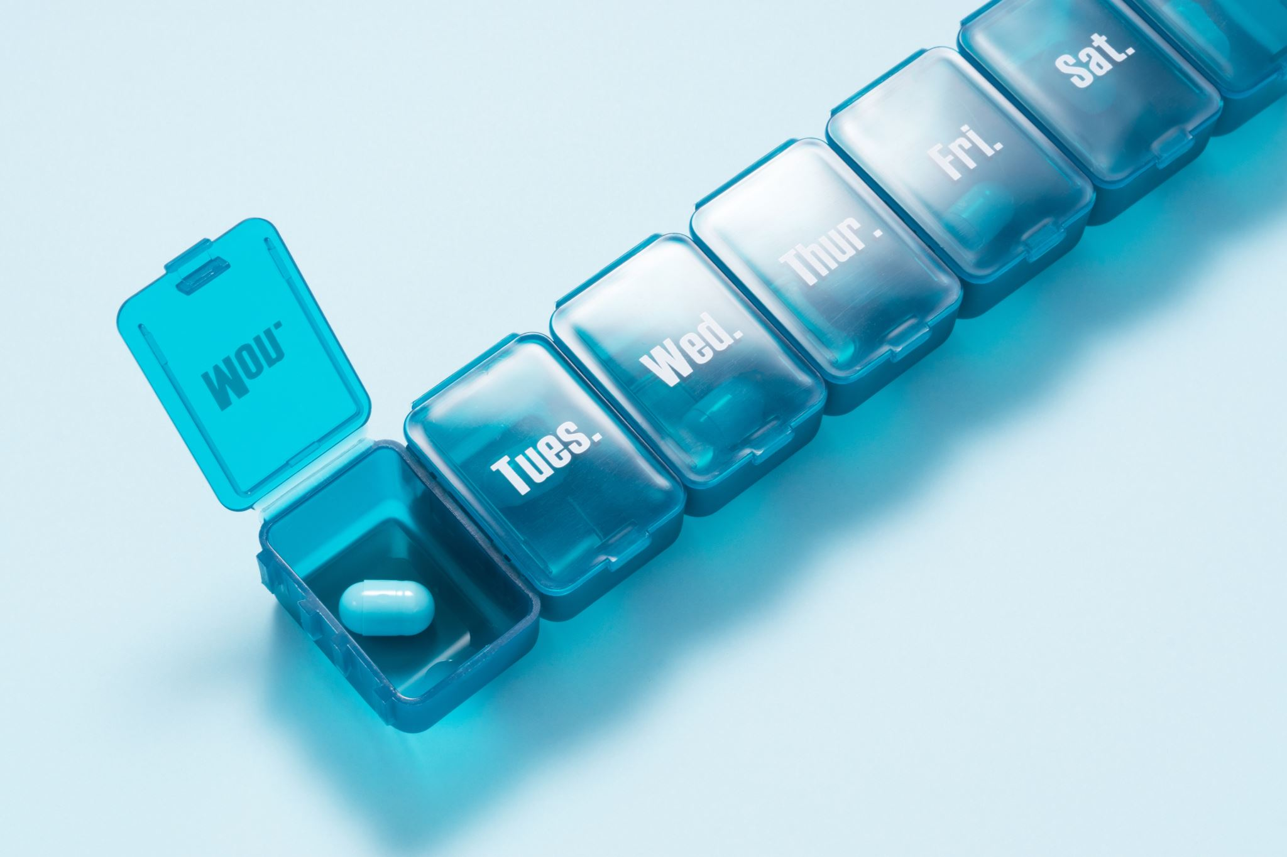
The system is divided into two main parts
Health Monitoring kit with IoT – How it works?
Medico Box – And how it helps the two sides, the physician and the patient

Slide 14
System process
Sensing
Processing
Cloud Server
Analysis

Slide 15
System process
Sensing – The parameters are collected from the sensor
Processing – The data that are sensed from the sensors will be processed to be ready
Cloud Server – Will receive the processed data to analyze and send it to the app to be displayed
Analysis – The data received after cloud server processing and display it on the platform, the application and depending on the change of this parameters the doctor will take action – The medical box will activate

Slide 16
Project requirements
The project main components:
Arduino Uno to get inputs and outputs and processing and combines the remaining components on it
OLED display screen to display the analysis of the data
Sensors (Temperature sensor and Pulse rate sensor) to sense the data
Node MCU the Wi-Fi module to receive and send the data throughout it (ESP8266)
Servo Motor we need to two servo motors to open and close the medico boxes

Slide 17
Project requirements
The project main components:
Motor driver (L293D) to manage the power supply and direction of the motor force
Color sensor (TCS230 Color sensor) to sense the color that the robot unit walk on it
IoT platform IoT it is the platform that provides to us the server and the application (Blynk IoT)
Blynk application for the doctor monitoring

Slide 18
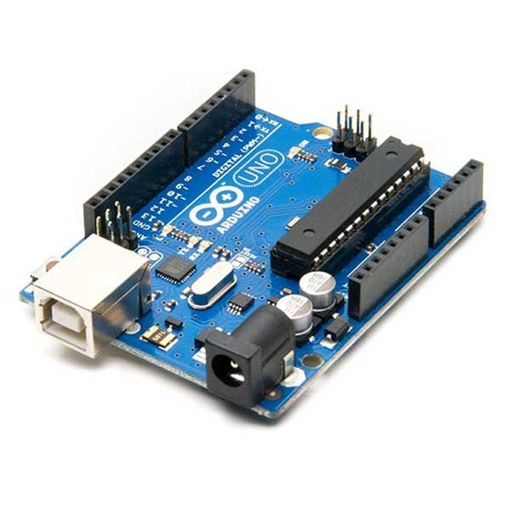
Arduino Uno
It is the brain of the system and manage the operation between the components by taking inputs and giving outputs

Slide 19
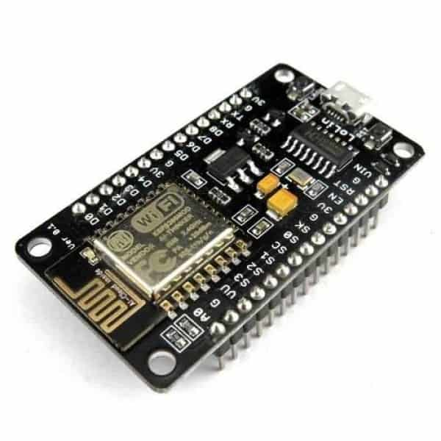
Node MCU
Open supply IoT platform it makes the communication between the IoT platform and the processing unit more easy to exchange the data

Slide 20
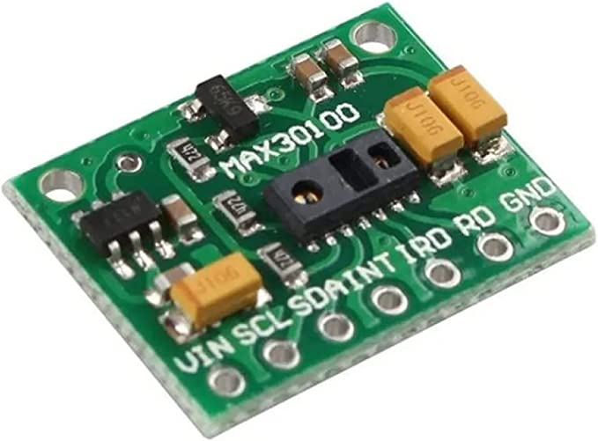
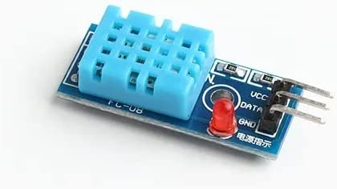
Temperature sensor & Pulse rate sensor
MAX30100 pulse Oximeter and heart rate
DHT11 Temperature sensor

Slide 21
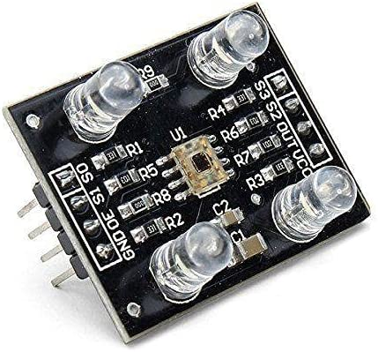
Color Sensor
Color sensor used for detect the track color to take the action

Slide 22
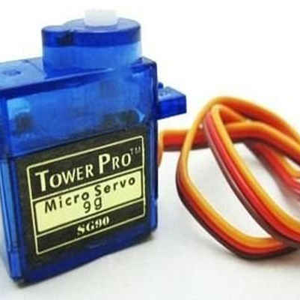
Servo Motor
Servo motor are used to open and close the medicine boxes

Slide 23
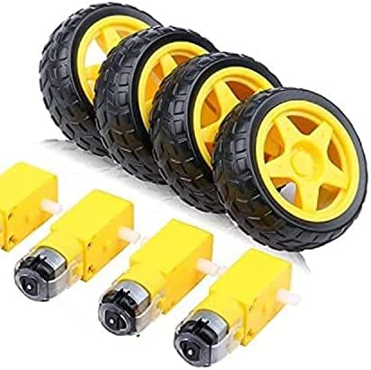
DC motor (With wheels)
DC motor are used to move the robot unit

Slide 24
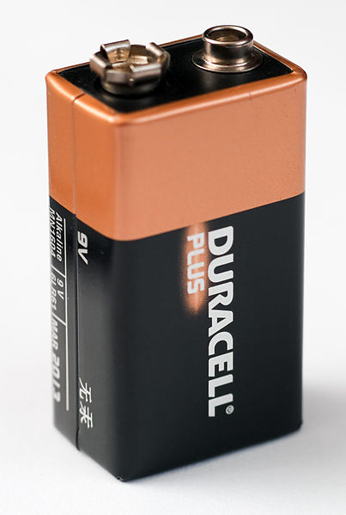
Battery (6V)
Power supply, to supply the project by the battery's voltage is 6 volt

Slide 25
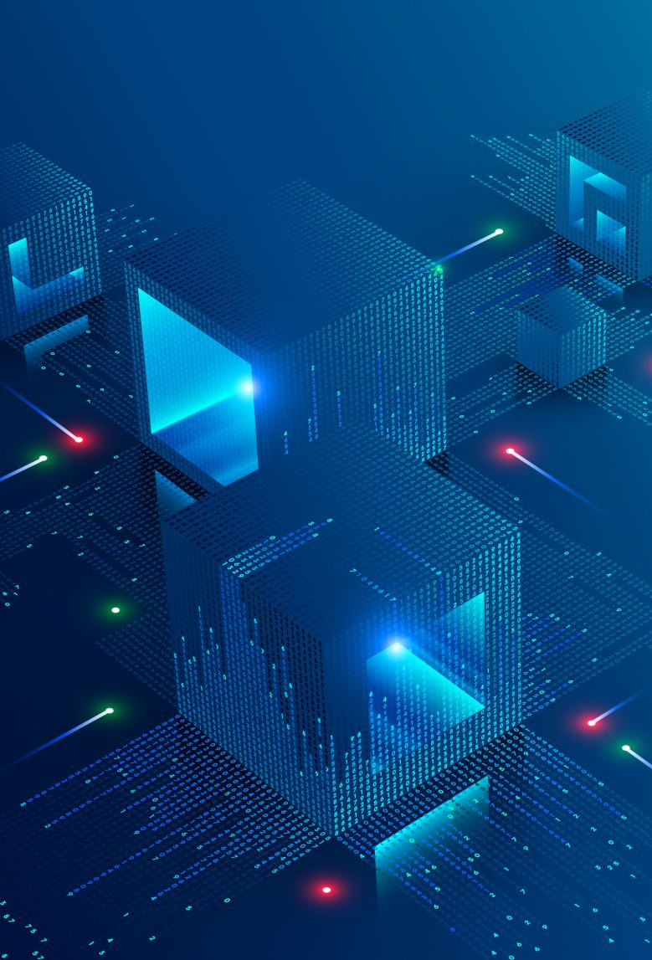
IoT platform
This platform provides to us the IoT platform
As a service (Paas) to store and analyze the data (Blynk platform)
Software as a service (Saas) to display and monitor the analyzed data (Blynk mobile application)

Slide 26
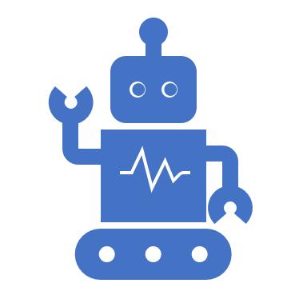
Expected final output
A robot unit, Act as alternative nurse
Gives the patient the medicine based on the doctor review
Monitors the patient's condition all the time
High performance for transmitting and receiving the data using the IoT technology

Slide 27
Problems faced
Searching for the hardware components are required for our project and needed sensors
Some components we bought from Amazon.eg and some of them from local market
Learning about Arduino software and how to implement our project (Coding)
How to design the circuit diagram for our project

Slide 28
What have we done till now?
We purchased the components of the project
Arduino Uno
Node MCU
Motors (Servo + DC motors)
Bread Board
OLED screen
Battery 6V
Sensors (Color sensor + DHT11 temperature sensor + Heart rate sensor)
Wires

Slide 29
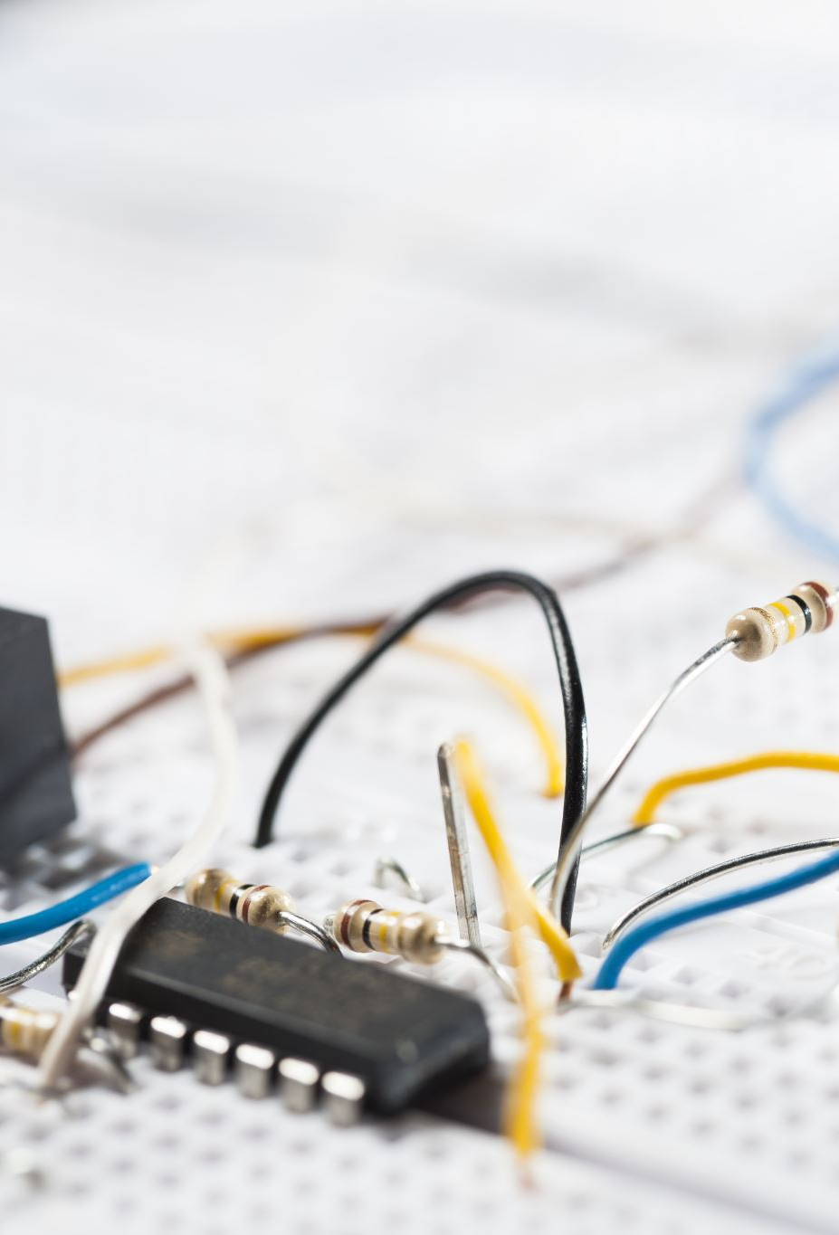
What have we done till now
And circuits for temperature sensor and heart rate sensor are implemented
The first circuit implementation for temperature sensor and humidity and heart rate sensor that collect the parameters for the patient and the room to display it on the OLED display and sending it to the IoT platform
We installed DHT11 library to connect the DHT chip and including it in the code

Slide 30
First circuit
We defined DHTPIN in pin 0 for Arduino inputs and the DHTTYPE is DHT11
After that we receive the humidity value and temperature value to print them
The second sensor that we used it to transmit and display the oxygen and the heart rate parameters, at first we define this libraries (Wire.h and MAX30100_PulsOximeter.h) and then we define that two pins for inputs the (SDA and SCL) in series pin 11 and pin 12 and GND for GND Arduino pin and the vin pin for voltage input

Slide 31
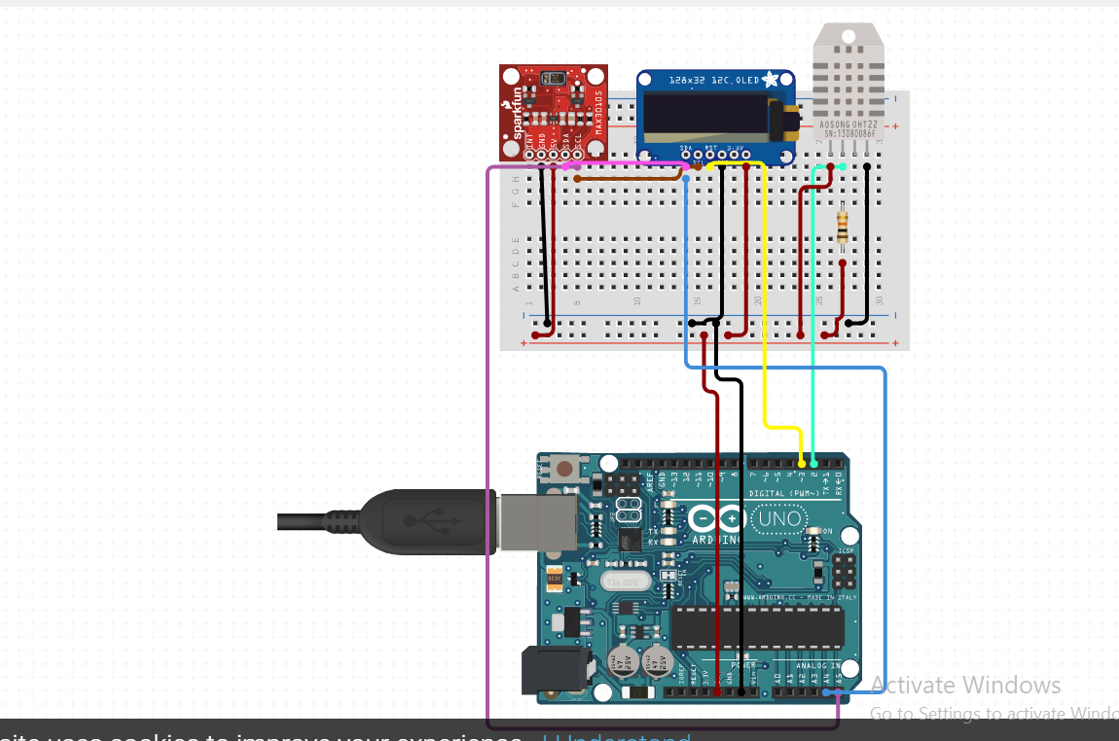
First Circuit

